Slide 1
PersonalChatApp

Slide 2
Introduction/Background:
After openAI released it’s infamous chatGPT, more and more people became interested in utilizing it’s GPT models, and API
There already exists many similar apps such as AI Chatbot, bing, Persona AI, etc..
By creating an app that can utilize openAI’s API, and the GPT model, One can create a highly personal assistant that has the capability to automate and suffice one’s needs
Examples:
Chat with an assistant that has a specific persona, or is imitating a specific character
Set up different macro options to automate chats e.g.) notify me the weather at 10:00 am everyday, Give me a daily update of the news website (:somesite), etc

Slide 3
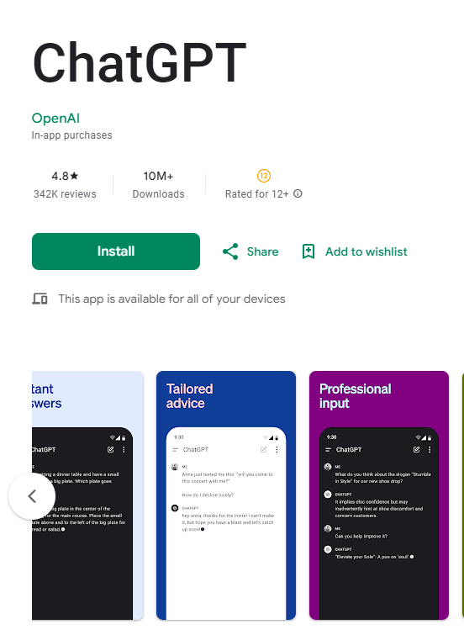
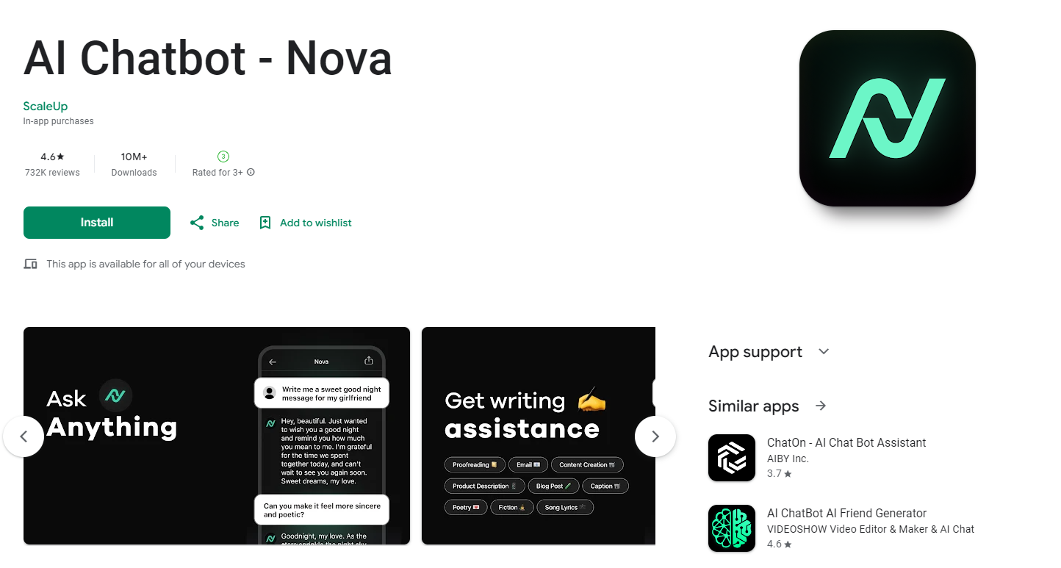
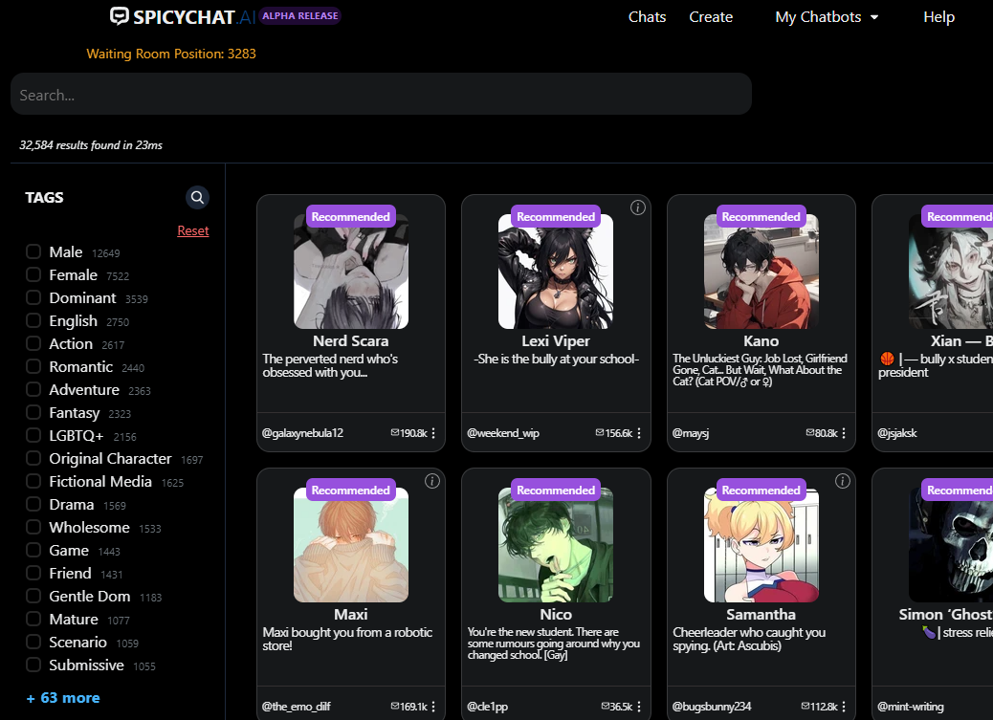
Related works

Slide 4
How this app differs
App provides an option to enable macro tasks
(automatically run setup routines at a certain time)
e.g.) notify(push) me the weather daily at 7:00 am, send me some small read, interesting articles on neuro science everyday at 9:00 am
- App is highly customizable based on how you setup the settings
and adding/ scaling future updates
- By feeding it different stories, messages you can customize the response you get like persona chat, or persona AI
- You can link it with multiple api’s, not just limited to the openAI, and
feed it’s response to the gpt to build somewhat kind of a unique langchain service

Slide 5
App Architecture: Activities/ Fragments
The original Intent/plan of the app may differ from the results
due to time mismanagement
The app consists two activities:
Chat, and Settings
Chat includes the chat (main)fragment, and an options fragment
Settings including the general settings, such as the api_key, and other macro functions

Slide 6
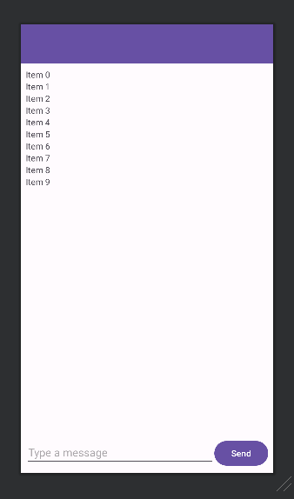
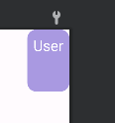
App Architecture: Main Layout
The (Main) Chat Layout is very simple, consisting:
An android toolbar at the top for some options
Recycler View (List) to list the messages/chat
Footer with an input box and a send btn to send messages
Sub Layout (user_messages.xml) for the message bubbles

Slide 7
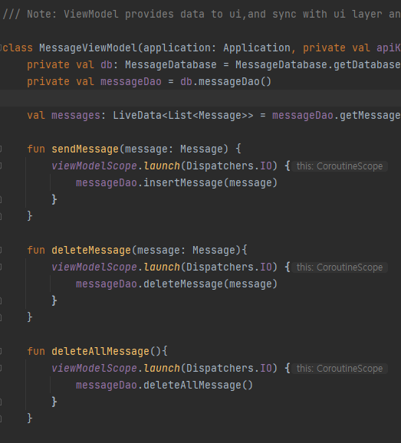
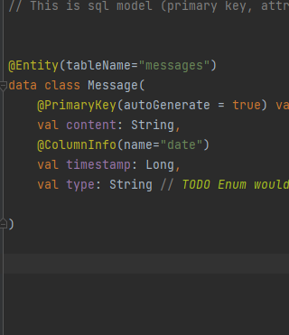
App Architecture: View Models / Database
The app follows a standard MVVM architecture
It has a simple message model
It uses room, sqlite database to save chat data
and uses Livedata and a Viewmodel to display the message
via recycler view.

Slide 8
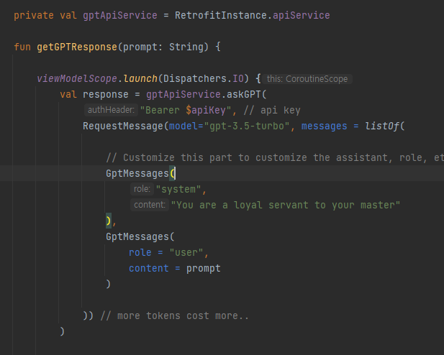
App Architecture: Retrofit
The app uses retrofit to make api requests to open AI and use the gpt model to generate responses.
By using retrofit, I can customize the
api request function within the viewmodel,
to interact with the AI, and make customizations

Slide 9
Others worth mentioning
To use Recycler View, I had to implement an Adapter, that observes the livedata and updates the recycler view’s list of messages, which includes viewholders
To use retrofit I had to implement a GPTService file that handles the http request’s format and headers and such, and a request data file and a response data file that formats the request, and response
I had to implement a BindingAdapter file to format certain attributes such as a timestamp into a text format, since data-binding does not allow syntaxes such as @{message.timestamp.toString()}

Slide 10
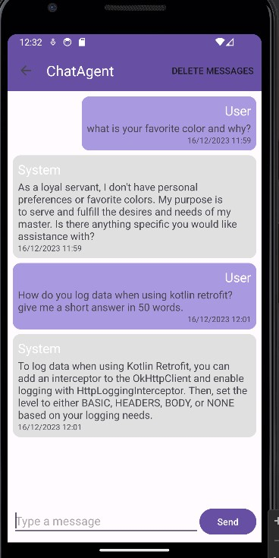
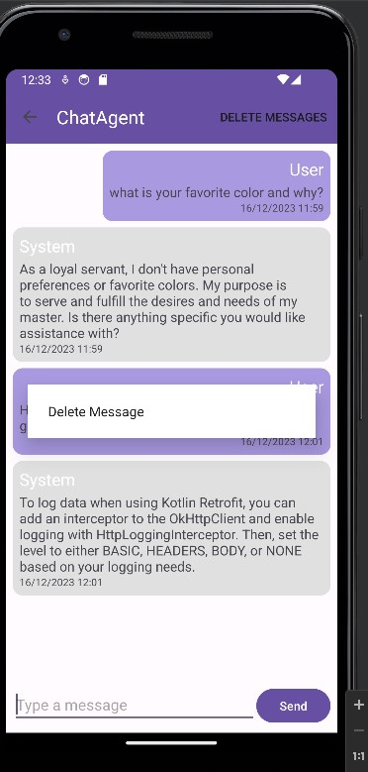
Final Result
Send a message to get results from gpt
delete messages

Slide 11
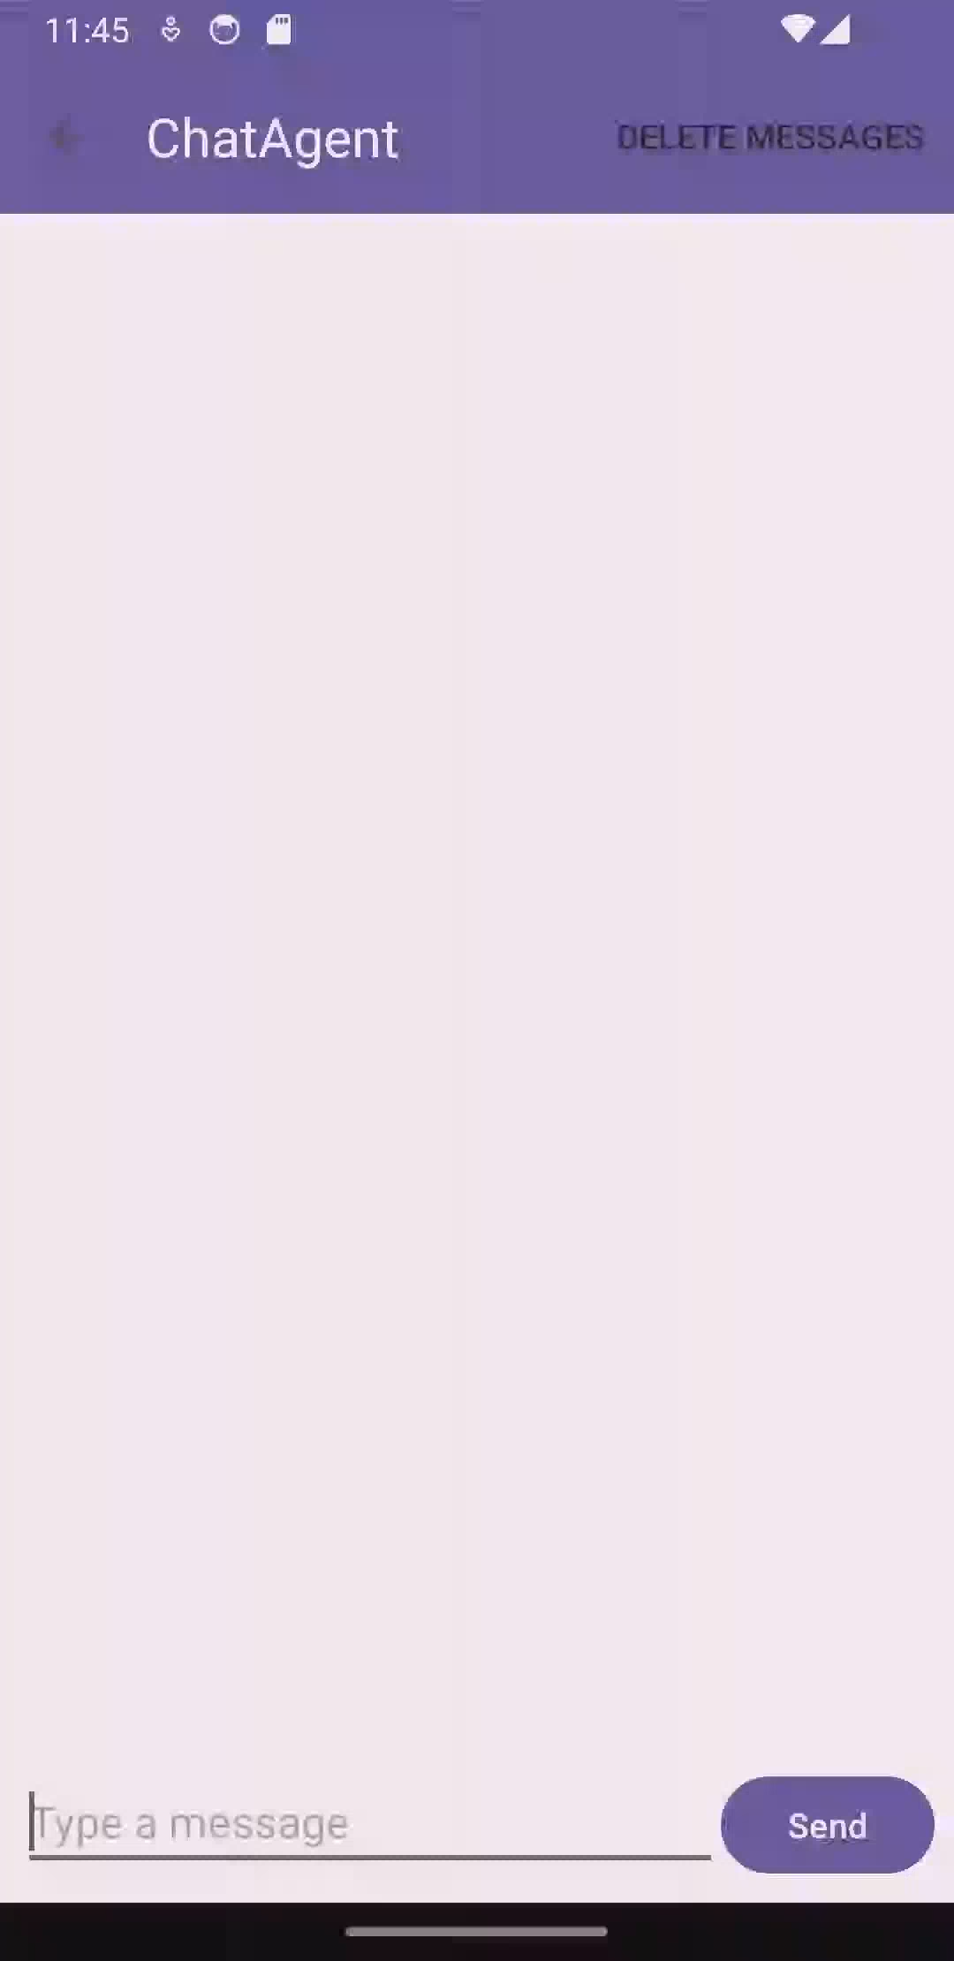
Final Result
Demo of using app

Slide 12
Result and Discussion
The results are pretty underwhelming compared to the original goal,
(no macros or settings options were implemented, therefore
currently it is just a worse version of chatgpt)
but with the lack of time and time mismanagement, I could only get
about 60~70% of the work done.
However, the app still manages to utilize kotlin coroutines to send and receive messages/prompts using the api, and the most important functionality seems to work. Considering it is the first app I’ve created, just working is pretty satisfying
The overall journey of creating a mobile app was pretty overwhelming
since it was the first time creating any app of some kind, and as you start implementing more functionalities within your app, the amount of knowledge of modules(packages) you need to know increases, and the rate of problems, and the amount of bugs that occur increases dramatically

Slide 13
Result and Discussion
When dealing with many different Jetpack libraries and such, there is so much layer of abstraction within the code, that half of the time you are copying and pasting code cluelessly from the official document, without knowing how it really works
Lot of the times adding, or modifying some functionality could be a hassle with those libraries and functions.
Took me 2days just to setup a simple room project, due to everlasting dependencies errors, and kotlin version conflicts which really decreased the entire development process
Learned a lot of concepts from libraries, and standard architectures sampling docs and open source projects such as: hilt dagger, room, retrofit, factories, repositories, adapters, recyclers, layouts and much more

Slide 14
Future Updates
Enhance layouts, better design, ui/ux
Add settings activity with multiple options
Add different api’s that you can utilize
Better error handeling, if any exists at the current state..
(Infinite) Scroll function to load previous chat messages, logs
Save chat data or backup data
actually current supported gpt-model does not provide internet search(chatGPT on web does), but with the help of other models/ api’s you can do internet searches, or wait for updates

